Slide 1

Designing a Production-Ready Fraud Decision System
Translating raw transaction data into an actionable, explainable system that protects revenue while preserving conversion

Slide 2
OVERVIEW
From Data to Decisions
01
02
Pattern Discovery
Feature Engineering
Identified concentrated abuse signatures in booking behavior and infrastructure
Translated patterns into auditable signals across exposure, urgency, and velocity
03
04
Model Validation
Decision Waterfall
Built attack-risk proxy with time-aware testing and explainability
Deployed three-tier system with clear reason codes and capacity controls

Slide 3
The Core Principle
The deliverable is not a model—it's a decision system
Real fraud systems require asymmetric response strategies. Automatic rejection only when confidence is high. Challenge when suspicious but uncertain. Accept the majority to protect conversion and customer experience.
The models are supporting components inside an auditable waterfall, not standalone predictors.

Slide 4

Managing Asymmetric Cost
Fraud Loss
Conversion Loss
Operational Capacity
Chargebacks, investigations, partner friction, and brand damage when attacks succeed
Revenue impact, trust erosion, and reputation harm from blocking legitimate customers
Review queues must stay manageable—challenge decisions need clear volume caps

Slide 5

Critical Pattern: The Zero-Night Cluster
Structured Abuse, Not Random Noise
Zero-night bookings showed dramatically lower authorization rates. But the signal strengthened when combined with geography and payment method.
Zero-night Stays
Overrepresented Payment
Specific Corridor
A specific corridor emerged—booker country, issuing country, and hotel country concentrated into predictable routes. American Express was overrepresented in this segment, creating a compound signature consistent with scripted testing rather than organic travel demand.

Slide 6

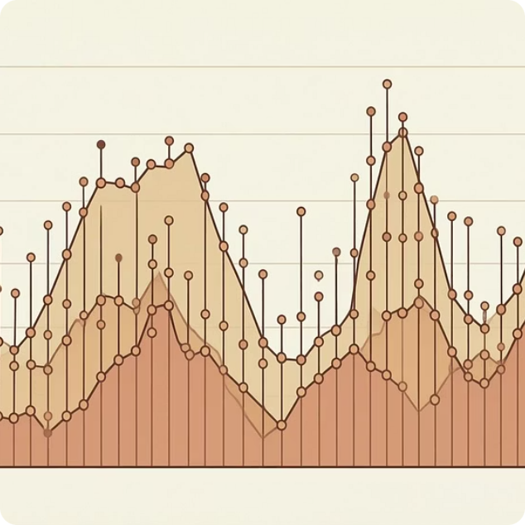

Velocity and Timeline Evidence
High-Velocity Entities
Attack Windows
Urgency Amplification
IPs and emails generating unusually high daily attempts across multiple cards—consistent with automation, not human booking behavior
Fraud outcomes concentrated on specific dates, suggesting coordinated campaigns rather than static background fraud
Country mismatch alone is normal in travel, but full mismatch combined with urgent booking and new properties elevated risk meaningfully

Slide 7
Engineered Features: Four Signal Families
1
2
3
4
Exposure & Economics
Urgency Signals
Consistency Scores
Behavioral Velocity
Booking window combined with mismatch creates interaction effects that map to real attack behavior
Mismatch gradient across booker, issuer, and hotel country—not naive rules, but combined inconsistency measures
Day-level metrics for IP/email activity, distinct cards touched, and churn ratios that flag infrastructure reuse
Price-per-night and log-scaled amounts capture expected loss variance—a €1,200 booking isn't the same risk as €120
Every feature has a clear explanation—no black boxes. If a booking is challenged, we can articulate exactly why.

Slide 8
The Attack-Risk Proxy Model
Why Not Predict "Fraud" Directly?
LightGBM Classifier
Time-Aware Validation
Confirmed fraud labels are sparse, delayed, and incomplete in short windows. Instead, we model attack risk—a real-time signal for abuse traffic worth challenging or reviewing.
Optimized for Precision@K and PR-AUC, not accuracy—top-of-list ranking matters operationally
Walk-forward splits prevent information leakage and reflect real deployment conditions
The proxy combines confirmed fraud with high-confidence testing signatures like insufficient funds plus velocity spikes, or refusals matching proven EDA patterns.
SHAP Explainability
This drives Challenge decisions, not automatic rejection—preserving defensibility.
Every score comes with reason codes like urgency-plus-mismatch or high churn velocity

Slide 9




Unsupervised Layer for Emerging Threats
Fraud tactics evolve. An Isolation Forest trained only on clean normal behavior provides coverage for unknown patterns without requiring labels.
Tight Baseline
Model learns only from verified normal traffic to establish behavioral boundaries
Capacity Control
Capped at top 1% anomalies per day to keep review workload predictable
Validation
Checked overlap with hot IPs and corridor clusters to confirm meaningfulness

Slide 10


The Production Decision Waterfall
Auditable, Balanced, Deployable
Accept: Majority of traffic flows frictionless to protect conversion and customer trust
Challenge Slice
Queue suspicious for review
Reject: Only high-confidence patterns like proven corridor signatures and velocity extremes
Reject Signatures
Challenge: Model-ranked attack-risk scores trigger authentication or manual review with clear reason codes
Block high-confidence infra
Accept Traffic
Allow majority flow
Every decision includes explainability. Operational capacity is controlled. This system balances fraud loss reduction with conversion protection—ready for production deployment.

